Slide 1


Group - 3
Pragati Galinde

Slide 2
PROJECT OBJECTIVES
To analyze sales overview and customer performance an production of a company within given year
We used
MS-EXCEL
MY-SQL
for analyzing ,cleaning and removing duplicates from dataset.
Prepared dashboard using
TABLEAU
POWER BI
we did calculations, merging and prepared interactive dashboards.

Slide 3




TOOLS

Slide 4
Contents
KPI-1 : Product Sales
KPI-2 : Customer Performance
KPI-3 : Sales and Production

Slide 5
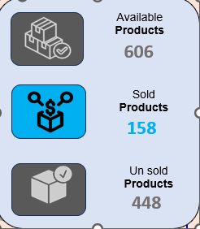
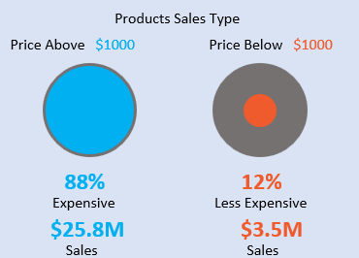
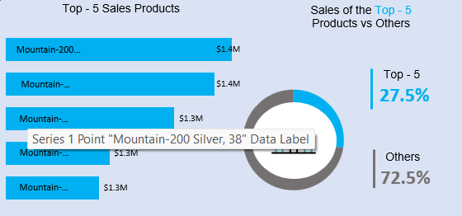
Product sales types
It is observe that there are price above $1000 is 88% is expensive and the sales is $25.8M.
AND PRICE BELOW $1000 IS 12% ONLY ITS LESS EXPENSIVE AND THE SALES $3.5M.
The top 5 sale products are 27.5% and others are 72.5%.

Slide 6
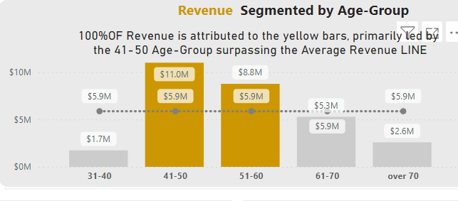
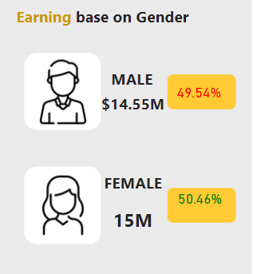
Customer performance
Adventure work project shows the revenue segment by age group under 100% of revenue is attributed to the Yellow bars.
Primary led by the 41-50 age –group surpassing the average revenue line.
The earning based on gender chart shows that under
Male group 49.54% with revenue $14.55M
Female is 50.46% with revenue 15M
The percentage of female is HIGH in nature

Slide 7
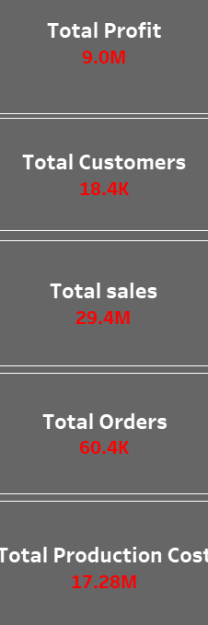
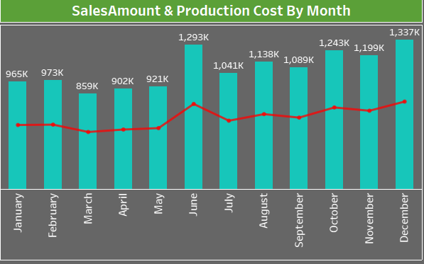
Sales and production
The sales amount and production cost by month chart shows that the month of order date June and December sales amount is high other are balanced in nature.
The adventure works sales and production are the total profit is 9.0M
total customers 18.4K
total sales 29.4M
total orders 60.4K
total production cost 17.28M

Slide 8
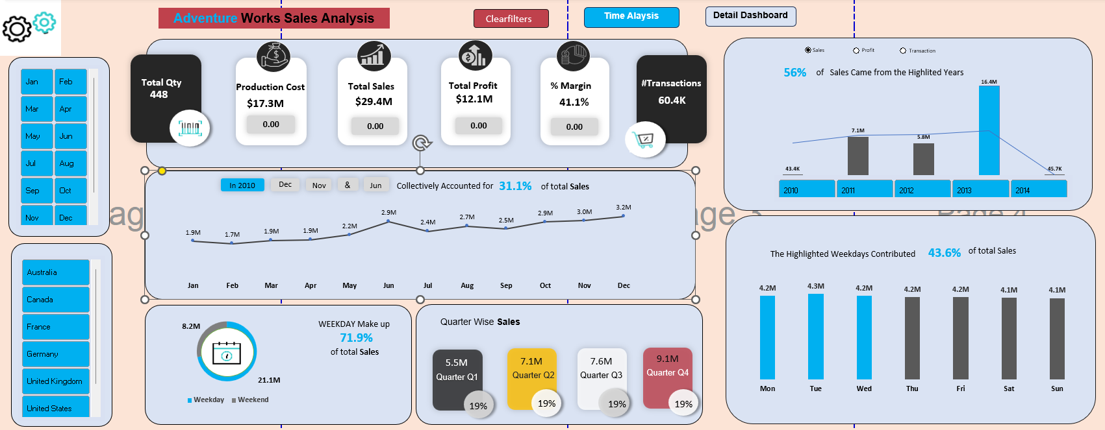
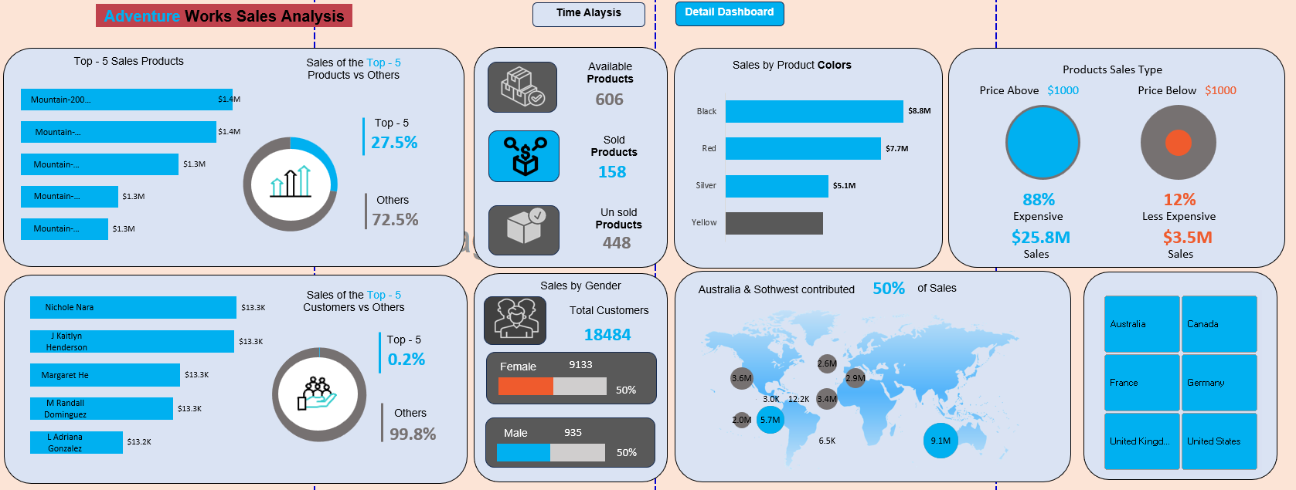
EXCEL Dashboard

Slide 9
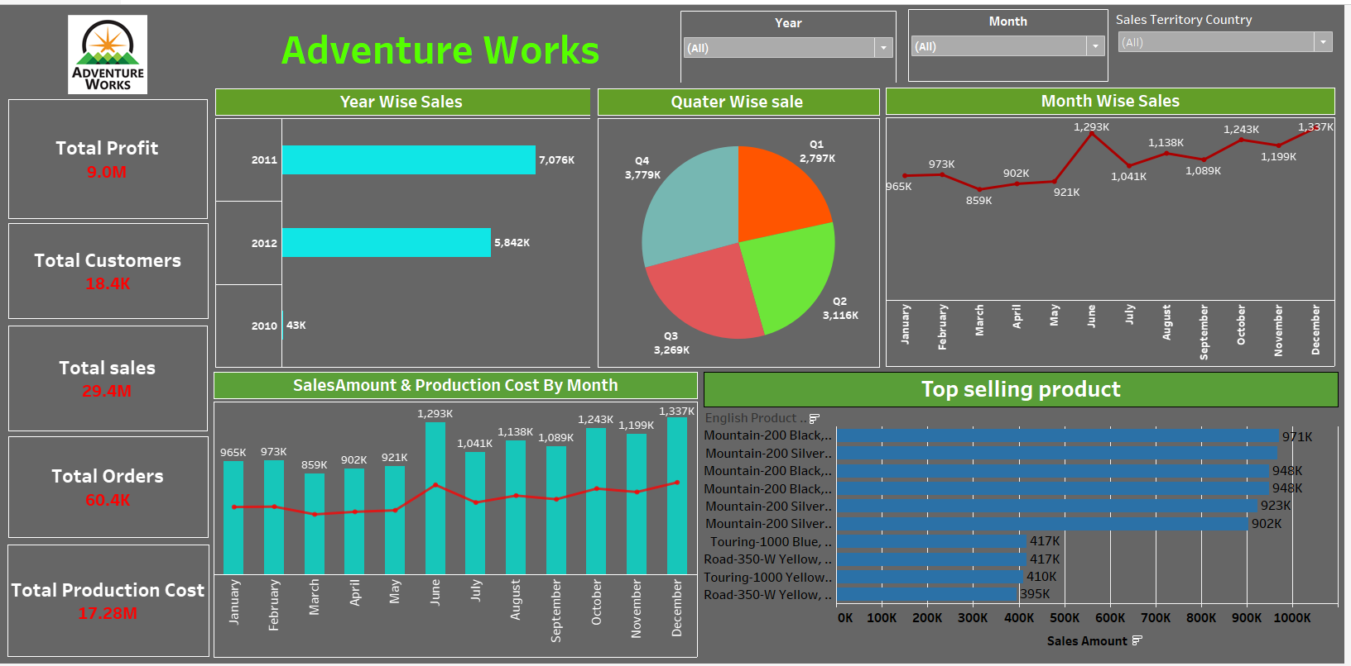
TABLEAU Dashboard

Slide 10
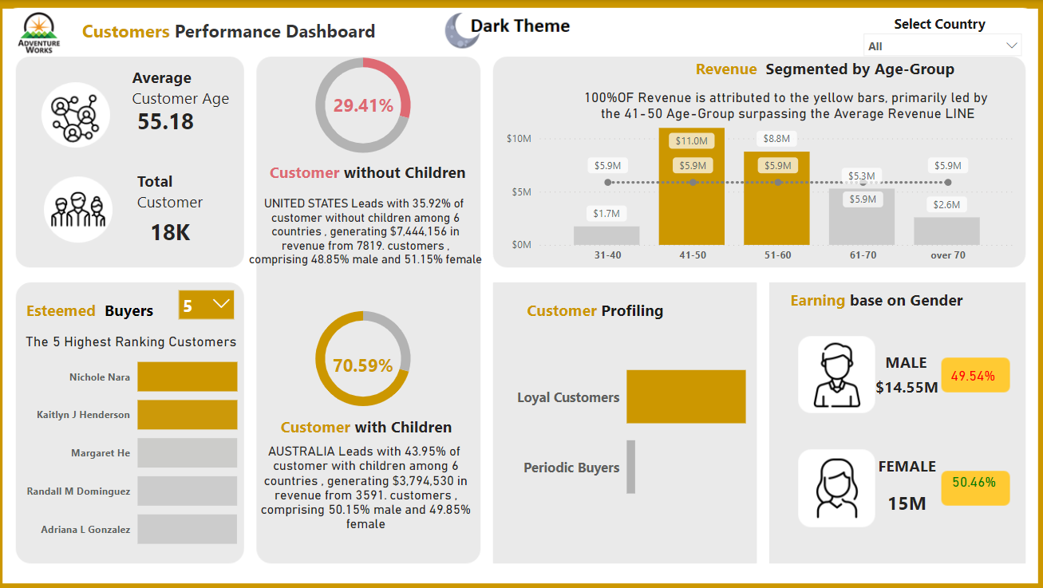
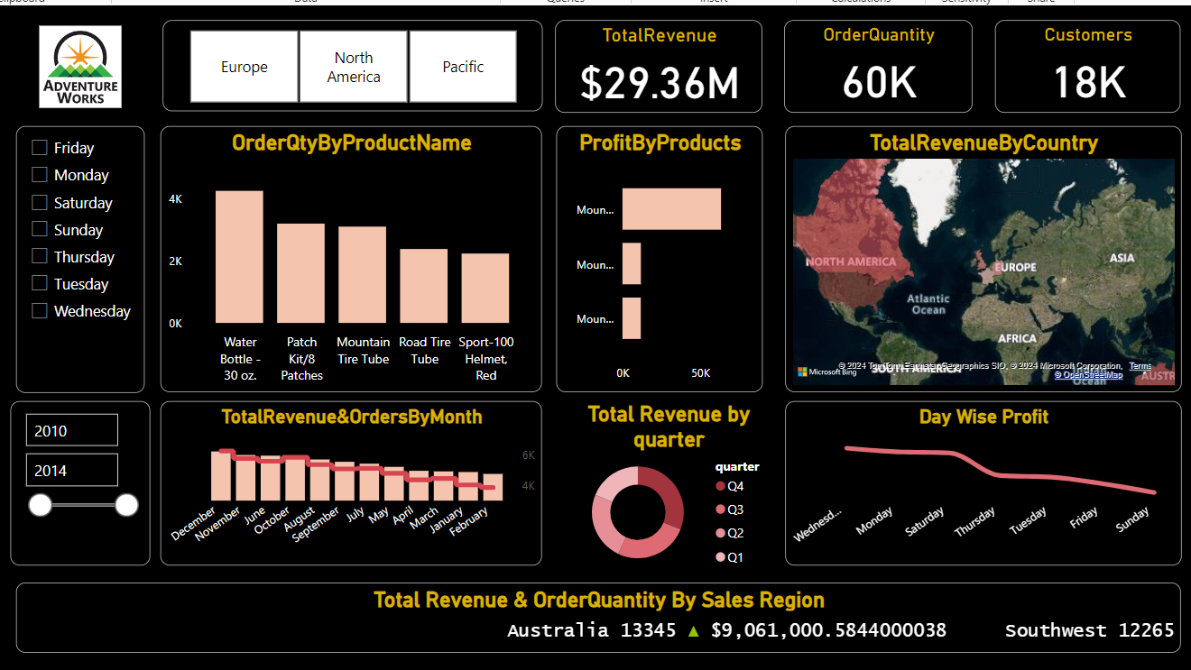
POWER BI Dashboard

Slide 11
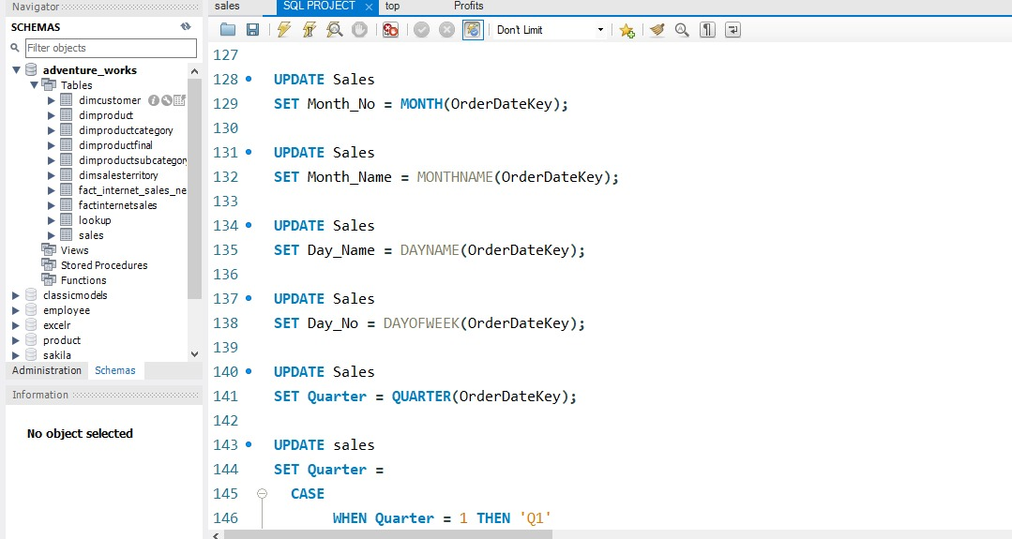
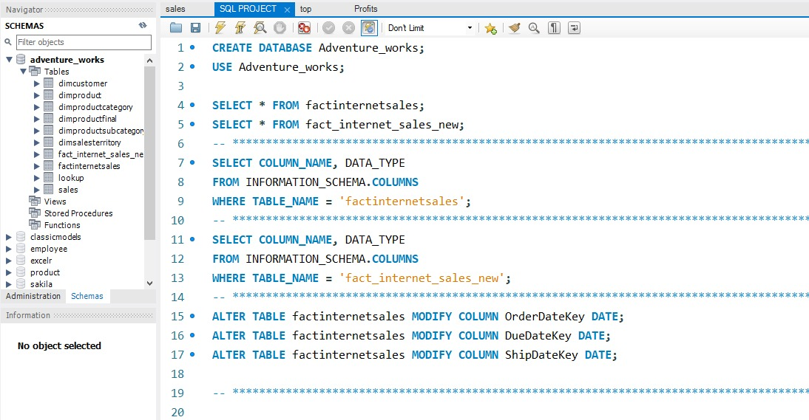
MYSQL Works

Slide 12
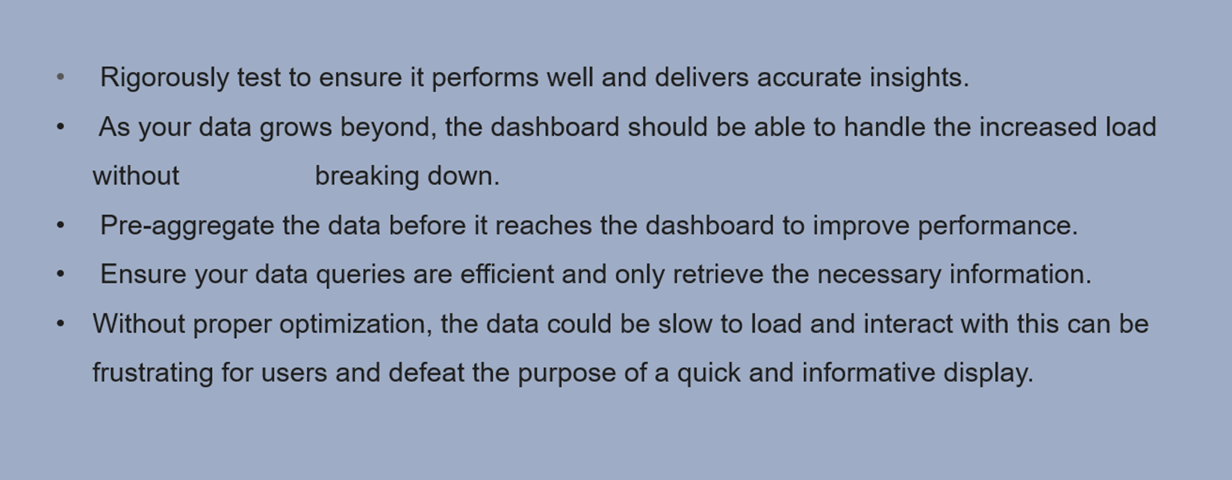
Challenges Faced

Slide 13
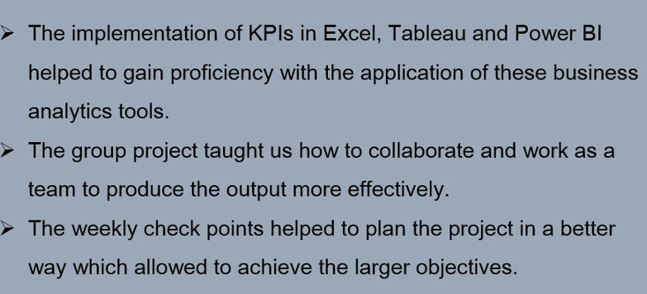
Outcome of the Project

Slide 14


